Slide 1
DevOps - Jenkins
presentation by
Nageswara Rao Allacheruvu

Slide 2
DevOps
Contents:
Introduction
DevOps, Jenkins
Continuous Integration, Deployment.
Advantages
Conclusion
References

Slide 3
Introduction
Jenkins is an extensible, open source continuous integration server. It builds and tests your software continuously and monitors the execution and status of remote jobs.

Slide 4
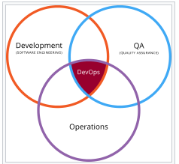
DevOps:
DevOps (development and operations) is an enterprise software development phrase used to mean a type of agile relationship between development and IT operations. The goal of DevOps is to change and improve the relationship by advocating better communication and collaboration between these two business units..

Slide 5

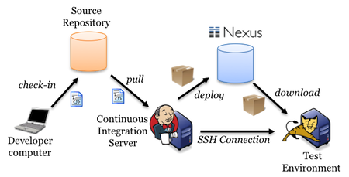
Jenkins
Jenkins:
CI tools: Hudson, Jenkins, Bamboo
Required Software : Jre, Tomcat, Jenkins, Operating system.
We can integrate the all tools ( Eg: SVN, ANT, Junit, CheckStyle, Sonatype Nexes repository, Ansible, Scripts, Apache Tomcat server..etc ) with CI tool and we do the build and deployment activities through the Jenkins.

Slide 6
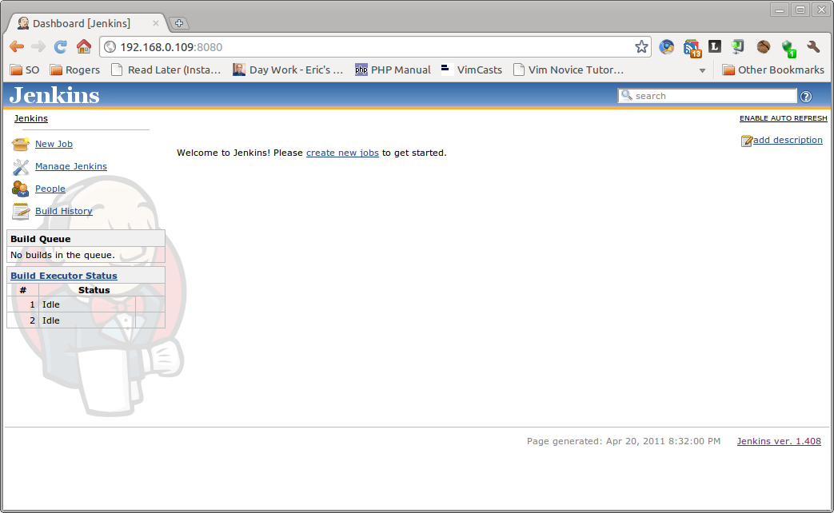
Jenkins Home page:
To Start Jenkins Jenkins : <Apache _home>/bin/ startup.sh / startup.bat
To Stop Jenkins Server : <Apache _home>/bin/ shutdown.sh / shutdown.bat

Slide 7
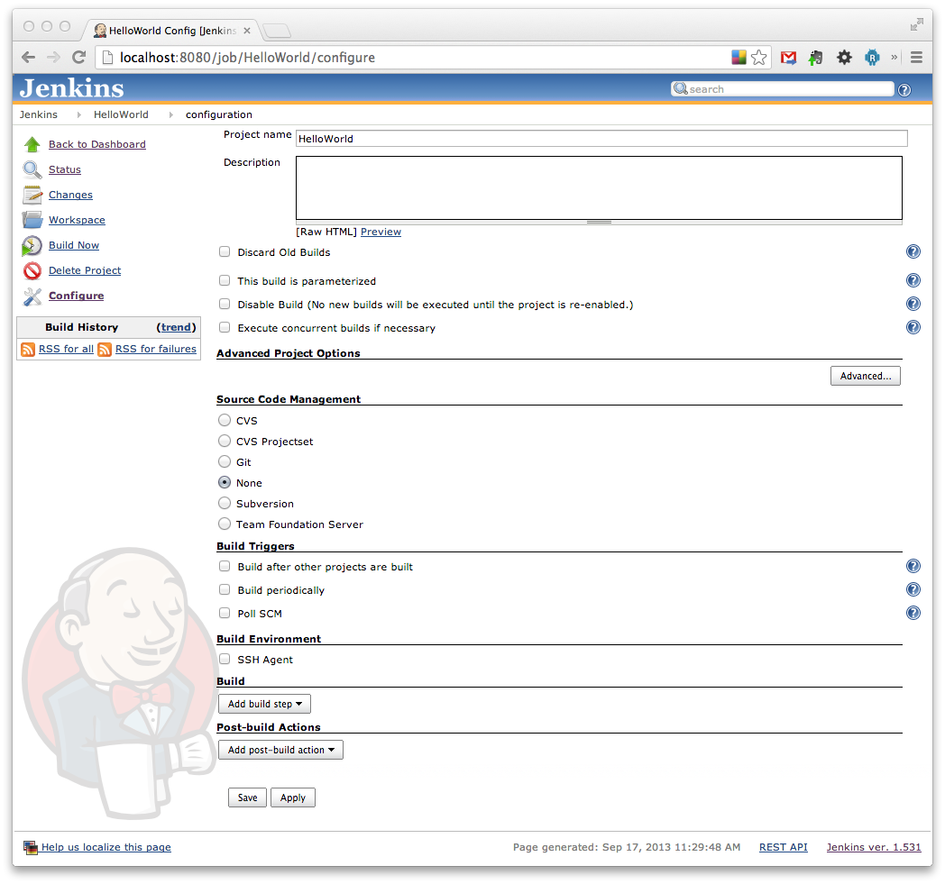
New job configuration in Jenkins

Slide 8
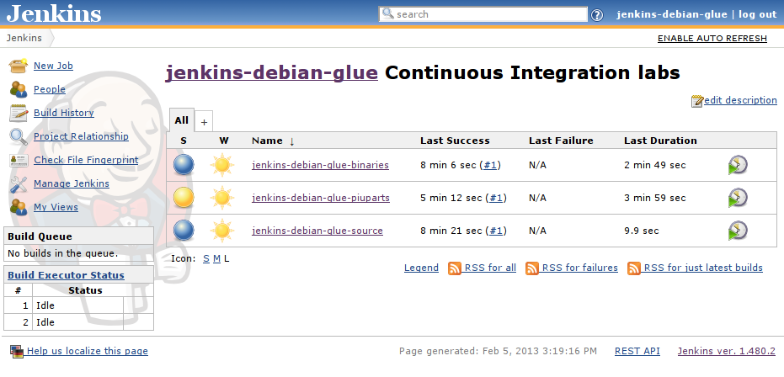
Build and Deployment job in Jenkins

Slide 9
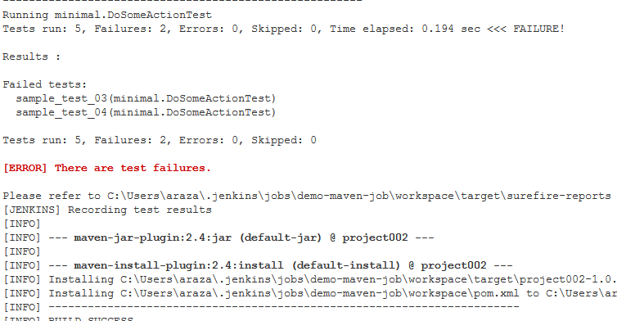
Jenkins job log information:

Slide 10
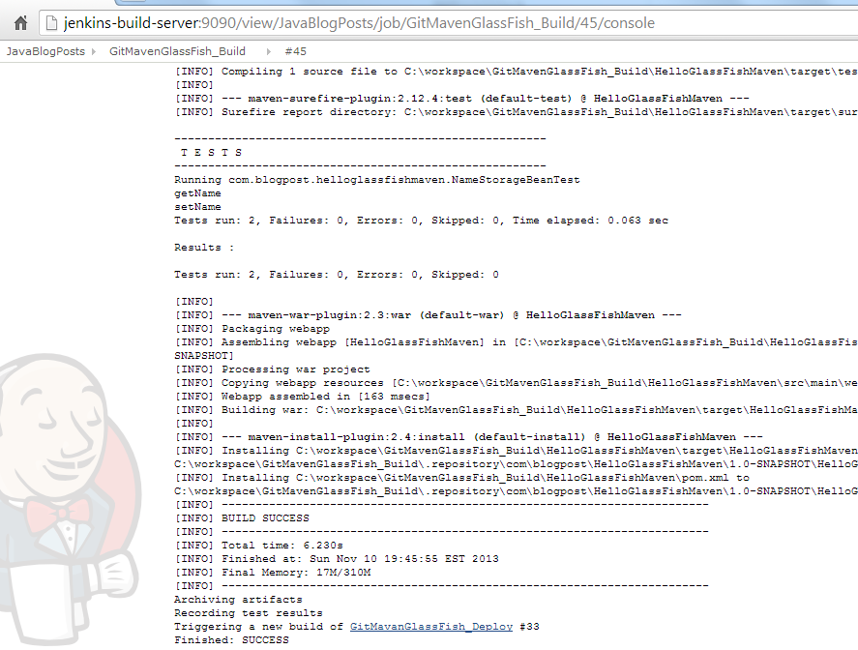
Success build job log information

Slide 11
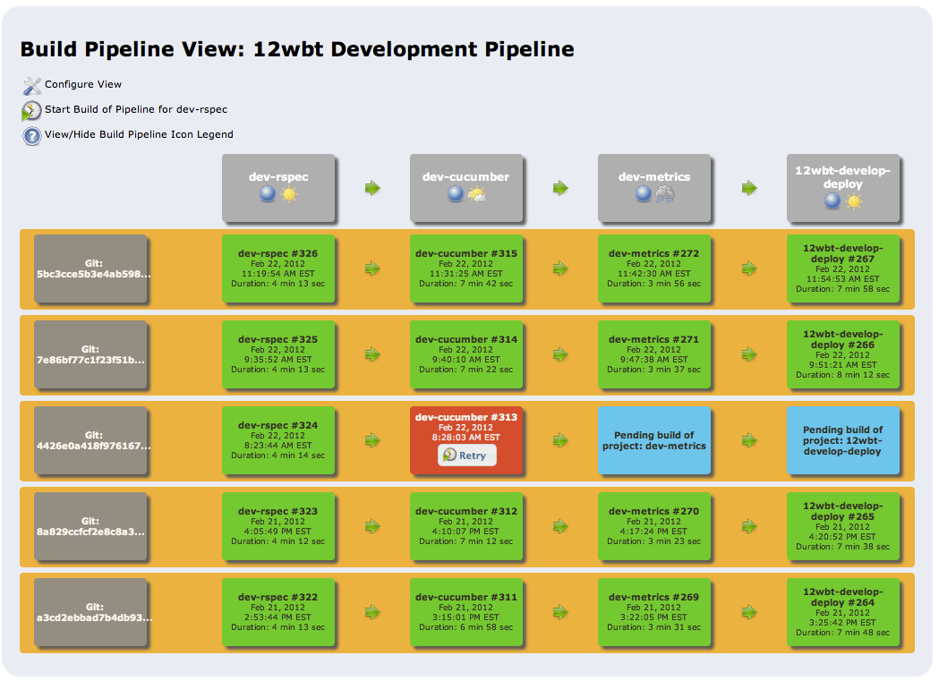
Jenkins – Sample Build pipeline View

Slide 12
Continuous Integration, Deployment
Continuous Integration (CI) is a development practice that requires developers to integrate code into a shared repository several times a day. Each check-in is then verified by an automated build, allowing teams to detect problems early.
Deployment: Deployment is nothing but place a binary file in server and restart the servers is call as deployment.

Slide 13
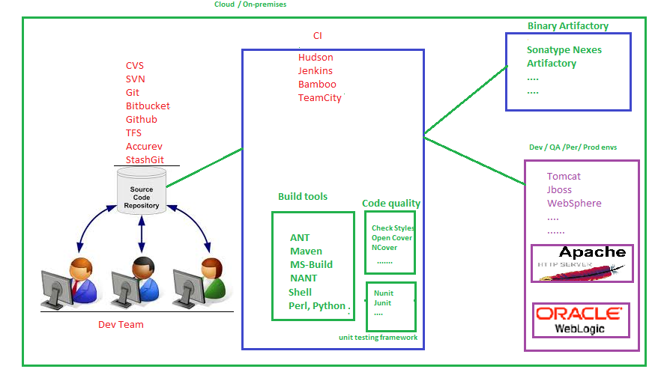
CI & CD flow :

Slide 14
Advantages
Reduce the Code integration issue.
Simple we can able to track the code quality health check
Get the email notification
Do the build and deployment activities
Security and productivity is more

Slide 15
Conclusion
Through Jenkins we can able to do build, deployment and provisioning infrastructure easily.
To track the history of build and deployment logs in the form of GUI.

Slide 16
References
References Continuous Integration – Martin Fowler
http://www.martinfowler.com/articles/continuousIntegration.html
Hudson
http://hudson-ci.org/ Hudson Continuous Integration Server
http://www.code-agazine.com/articleprint.aspx?quickid=0906071&printmode=true
The Hudson Book
http://www.eclipse.org/hudson/the-hudson-book/book-hudson.pdf
Jenkins
https://wiki.jenkins-ci.org

Slide 17


Slide 18
.
Thank you
-

